Slide 1
iOS Voice Controller
Tutorial 4 Extension

Slide 2
Overview
SocketClient
Voice Control

Slide 3
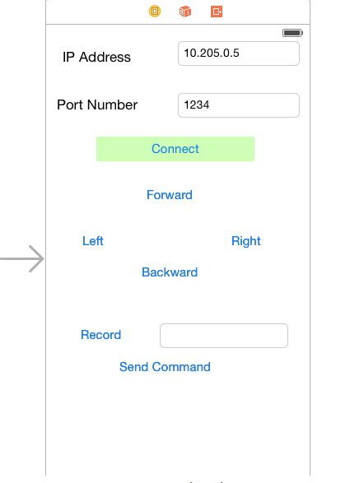
User Interface of iOS Voice Controller

Slide 4
Socket Client
Socket Client is based GCDAsyncSocket
Connects to Robot which GCDAsyncSocket Server
Reference :
https://github.com/robbiehanson/CocoaAsyncSocket/wiki/Intro_GCDAsyncSocket

Slide 5
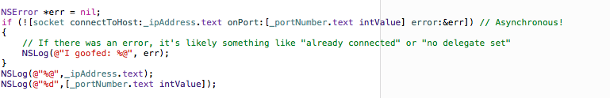
Code Snippet
Socket Creation
Socket Connection
Writing into Socket

Slide 6
Voice Recognizer
Voice Recognition from Nuance Mobile Developers
To use this service, sign up in the below link
http://nuancemobiledeveloper.com/public/index.php?task=home
Reference : http://www.raywenderlich.com/60870/building-ios-app-like-siri

Slide 7
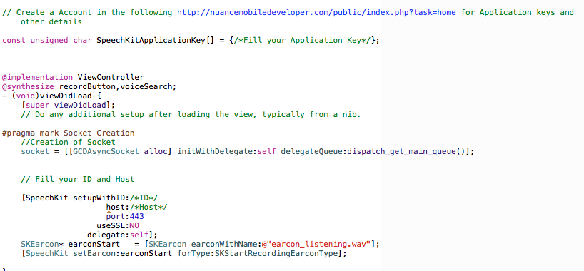
Code Snippet

Slide 8
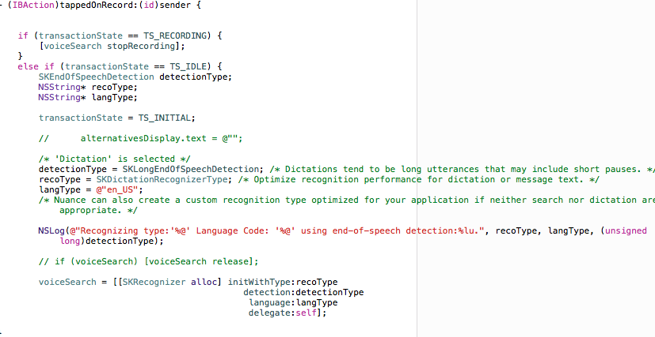
Code Snippet

